Slide 1
Chapter 16
Strategic Management Accounting

Slide 2
Objectives
After studying this topic you should be able to:
Discuss the development and key elements of strategic management accounting
Understand the difference between traditional and strategic management accounting
Evaluate key analytical tools which link management accounting with strategy

Slide 3
Strategic Management Accounting (SMA) Definition
“a form of management accounting in which emphasis is placed on information which relates to factors external to the firm, as well as non-financial information and internally generated information”
CIMA official terminology, 2005, p54

Slide 4
Conceptions of SMA
The first is the attempt to incorporate strategic ideas into management accounting by taking generic strategy tools and looking at what management accounting information can used to support strategy.
The second that it is designed to align management accounting with marketing management for strategic positioning. This view looks at the marketing tools used by businesses and uses management accounting within those tools.
The third is that it is just a name to group together many of the contemporary approaches in management accounting that have developed which have a strategic implication. There are a number of contemporary approaches to management accounting which have been marked as strategic management accounting techniques because of their external and market orientated content.
Roslender and Hart (2010)

Slide 5
A comparison of the traditional and strategic approaches to management accounting
Traditional Approach | Strategic Approach
Financial Focus | Value Focus
Absorption costing for Cost allocation | Marginal costing, target costing
Cost control orientation | Customer Value orientation
Internally Focussed | Externally orientation
Performance Measurement financial | Multi-dimensional performance measurement and benchmarking
Fragmented systems | Integrated Systems
Accounting and operational information separate | ERP and accounting systems integration
Profit motives short term | Profit motive longer term
Pricing short term cost orientated | Pricing market driven and strategic

Slide 6
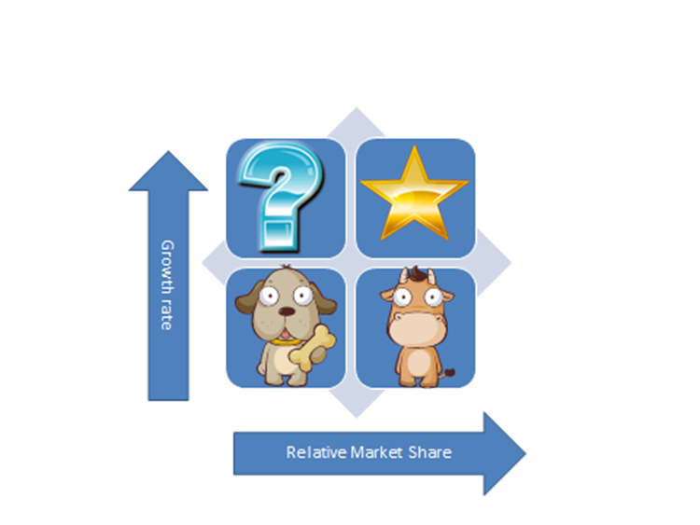
Boston Matrix

Slide 7
Value generation
Michael Porter (1985) identified two main types of competitive advantage:
Cost advantage | Achieved by provision of a product or service at a lower cost than your rivals
Differentiation advantage | Achieved by provision of a product or service which can be distinguished from the competitors and potentially allows a premium price to be charged

Slide 8
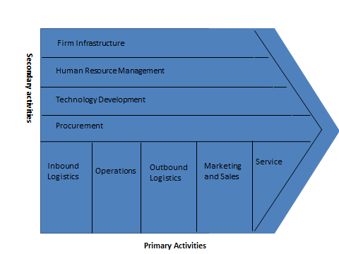
Porter (1985) Value Chain

Slide 9
Comparison of Value Chain for a Fast food and fine dining restaurant
Primary Activities | Fast Food | Fine Dining
Inbound logistics | Probably outsources, focus on cost and consistency | Typified by local supply, focus on quality and provenance
Operations | Automation, standard processes | Bespoke service, artisan values
Outbound logistics | Automation, customer processing systematic | Customisation, service environment critical, ethos central to delivery
Marketing and Sales | Price based marketing | Reputation and value based marketing
Service | Counter service, standardised | Silver service, customised

Slide 10
Comparison Continued
Secondary Activities | Fast Food | Fine Dining
Infrastructure | Centralised organisational structures, compliance culture, technical control systems | Entrepreneurial, small businesses, entrepreneurial culture, cultural control systems
Human Resources | Low skill levels, standard operating practices, workforce commoditisation, high turnover | High skill levels, HR competences strategically critical, highly valued, key staff head hunted,
Technological Development | Technology important, Information systems highly sophisticated automated ordering, standard recipes | Technology less important, based on quality equipment, contemporary high quality fixtures and fittings
Procurement | Probably outsourced, focus on cost and consistency | Typified by local supply, focus on quality and provenance

Slide 11
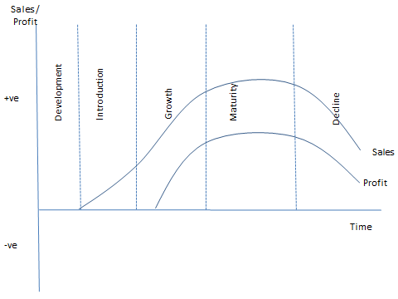
Product Lifecycle

Slide 12
Lifecycle return can be maximised by:
Maximise the length of the life cycle
Identify the design costs of the product/service
Minimise the time to market
Manage the projects cash flow

Slide 13
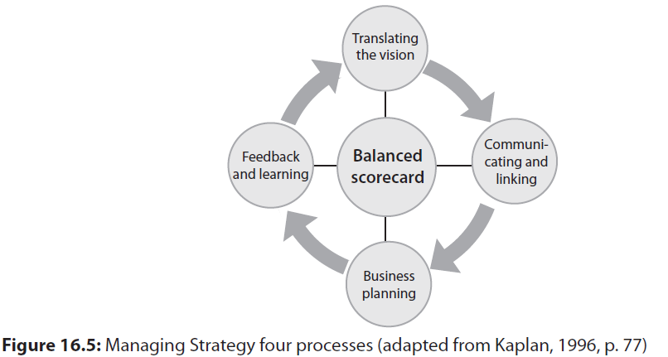
SMA Techniques
The balanced scorecard (BSC) – linked with strategy

Slide 14
Other Tools of SMA
Activity Based Management
Attribute Costing
Competitor Analysis
Brand Valuation
Target Costing
Strategic Costing

Slide 15
Summary
Strategic management accounting addresses weaknesses in traditional management accounting.
The modern market place requires a strategic focus to be applied to management accounting information and decision making.
A number of strategic management accounting tools have been established to meet the needs of strategic management accounting information.

